Slide 1



SE Capestone Project Architecture

Slide 2




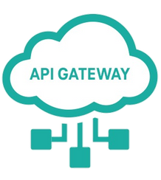
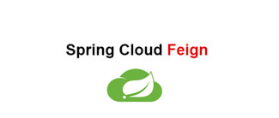

Backend Architecture :
Discover Server
UserAuthentication Service
Client
Kanban-Board Service

Slide 3
Class Diagram :
UserAuthentication Service
User
Domain
EmailId
Password
Attributes

Slide 4
Class Diagram :
Kanban-Board Service
User
Board
Stages
Task
Member
Domains
EmailId
Password
UserName
Profession
List<Board>MyBoards
BoardId
BoardName
List<Stages> myStages
List<Member>myMembers
StageId
StageName
List<Task> myTasks
TaskId
TaskName
TaskImage
TaskPriority
Member taskMember
MemberEmailId
MemberName
Attributes

